Slide 1
7
Introduction to t Tests: Single Sample and Dependent Means

Slide 2
Problem!
We’ve been working on the assumption that we’ll know the population mean and standard deviation
  Really?!

Slide 3
T-test
T-test – hypothesis testing procedure in which the population variance is unknown
  Compares t-scores from a sample to a comparison distribution called a t-distribution

Slide 4
Estimated Population Variance (S²)
In order to compare a sample mean to a population with a known mean, but an unknown variance, the variance of the population must be estimated
  Usually, the only information available about a population is a sample from the population
  Therefore, the assumption that Populations 1 and 2 have the same variance is necessary

Slide 5
Representativeness of the Population
Variance of the sample should provide information about the population
  If the sample variance is small – the population variance is probably small
  If the sample variance is large – the population is probably large

Slide 6
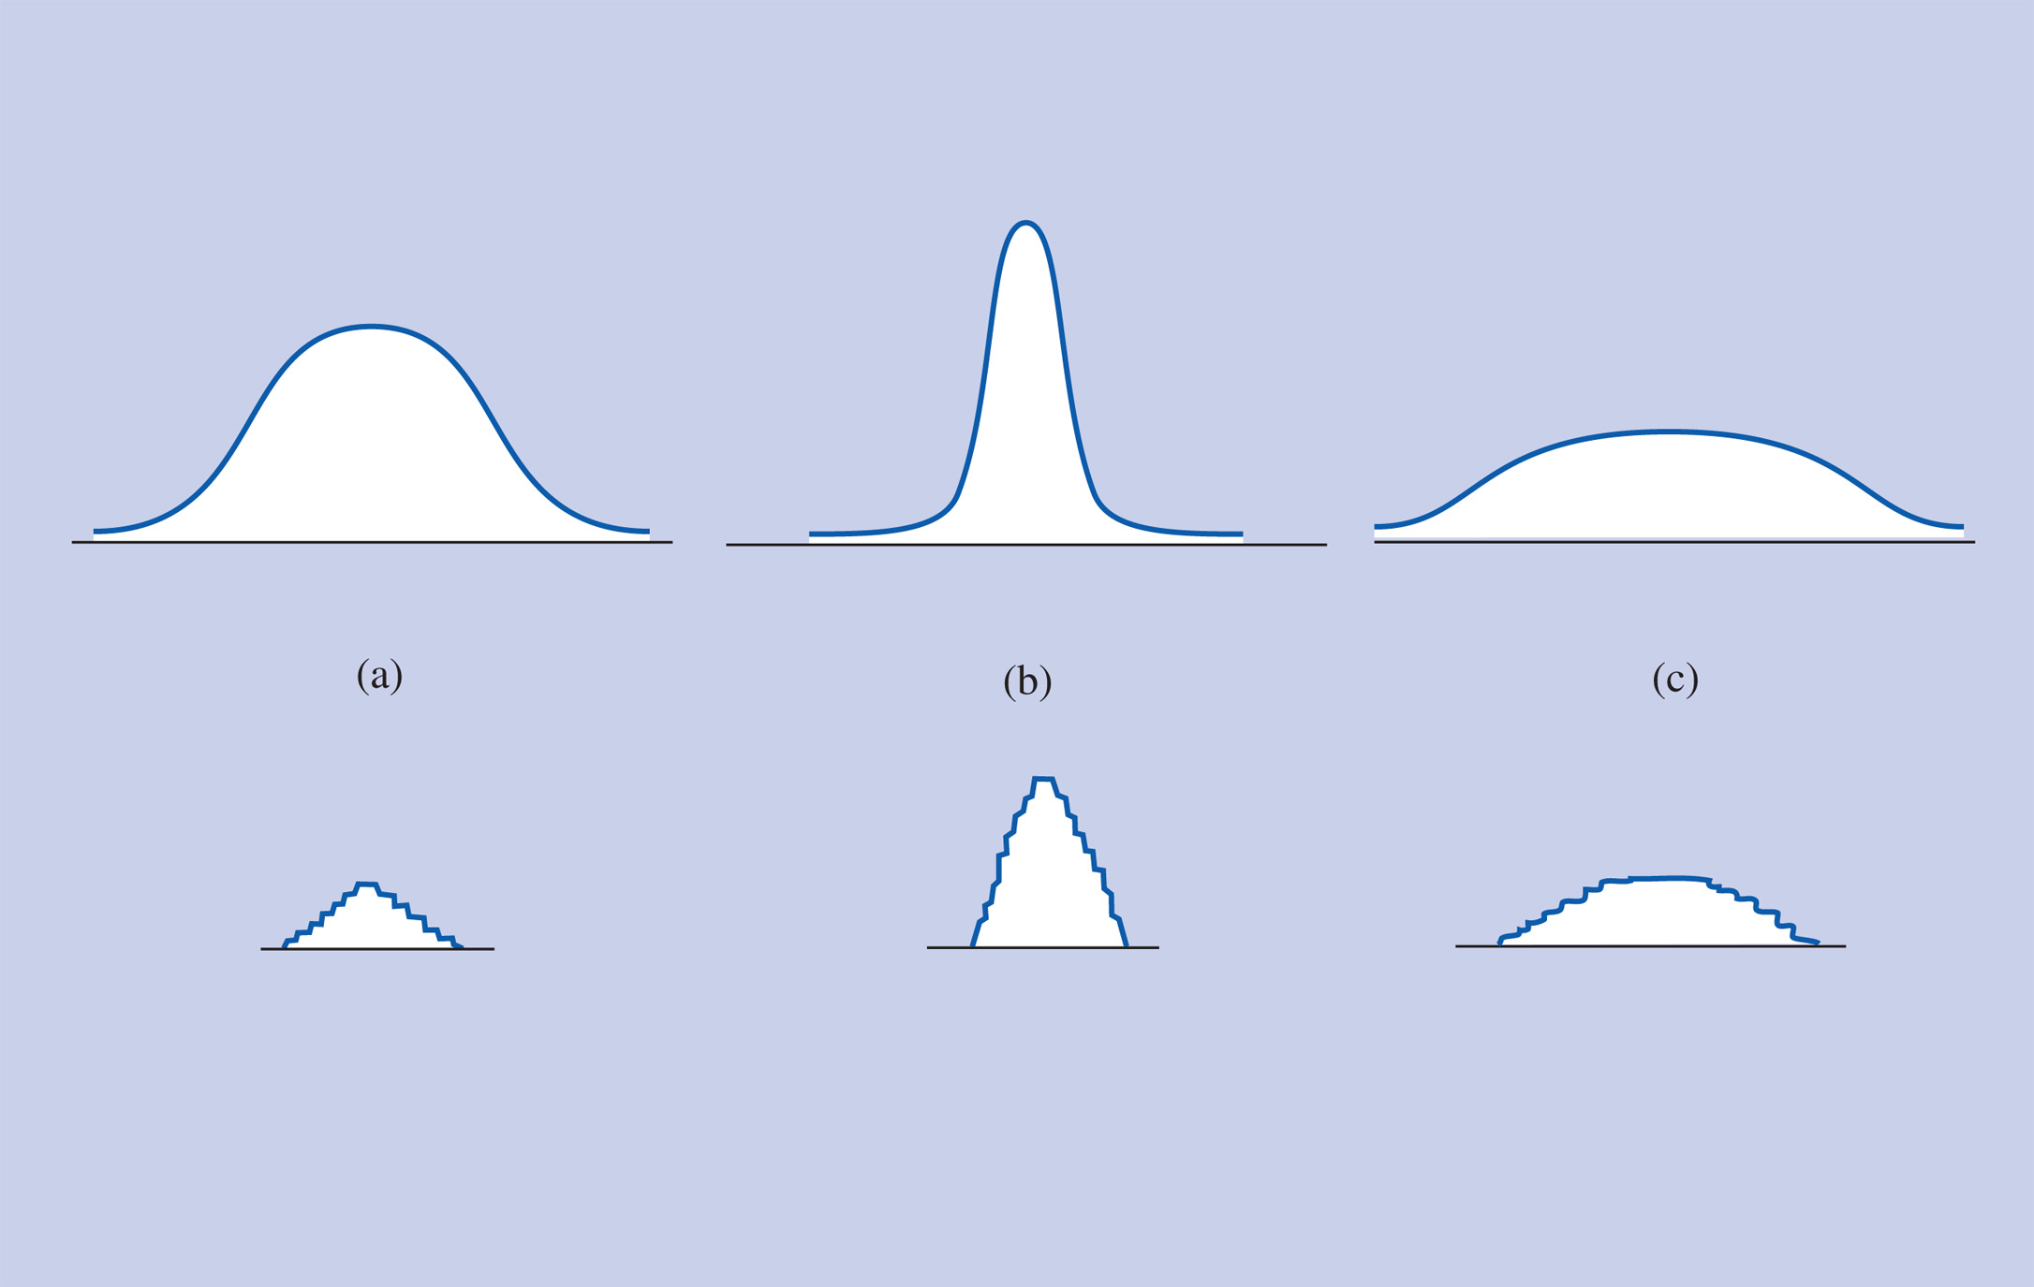
Figure 7-1 The variation in a sample’s scores (shown in the lower distributions) is similar to the variation of scores in the population from which the sample is taken (shown in the upper distributions).

Slide 7
Estimating the Population Variance -1
A sample's variance cannot be used directly as an estimate of the population variance
It can be shown mathematically that a sample's variance will, on the average, be smaller than its population's variance

Slide 8
Estimating the Population Variance -2
Ordinarily, variance is figured as the sum of squared deviations from the mean divided by the number of participants in the sample: SD² = SS/N, which gives a biased estimate of the population variance

Slide 9
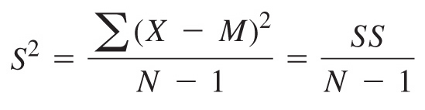
Estimating the Population Variance -2
An unbiased estimate of the population variance (S²) is obtained by modifying the formula:

Slide 10

Estimating the Population Variance -3
Degrees of freedom
  Number of scores that are “free to vary”
  There are N-1 degrees of freedom because when figuring the deviations, each score is subtracted from the mean
  Thus, if all the deviation scores but one are known, the last score can have only one value
  Therefore,

Slide 11
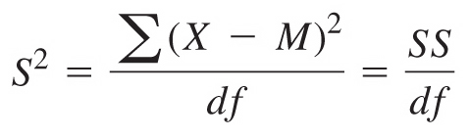
Estimating the Population Variance -4
Therefore, the formula for S² using degrees of freedom can be written

Slide 12
Important Distinction
When estimating population variance, divide the sum of squared deviations by the degrees of freedom (N-1)
When figuring the variance of the distribution of means, divide the estimated population variance by the full sample size (N)

Slide 13
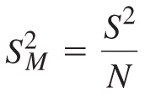

Variance of the Distribution of Means
The variance of the distribution of means
The standard deviation of the distribution of means
.

Slide 14
Accuracy in Estimating S²
Accuracy is lost when estimating the population variance
Adjust for this loss by making the cutoff sample score for significance more extreme
An exact distribution takes this loss of accuracy into account

Slide 15
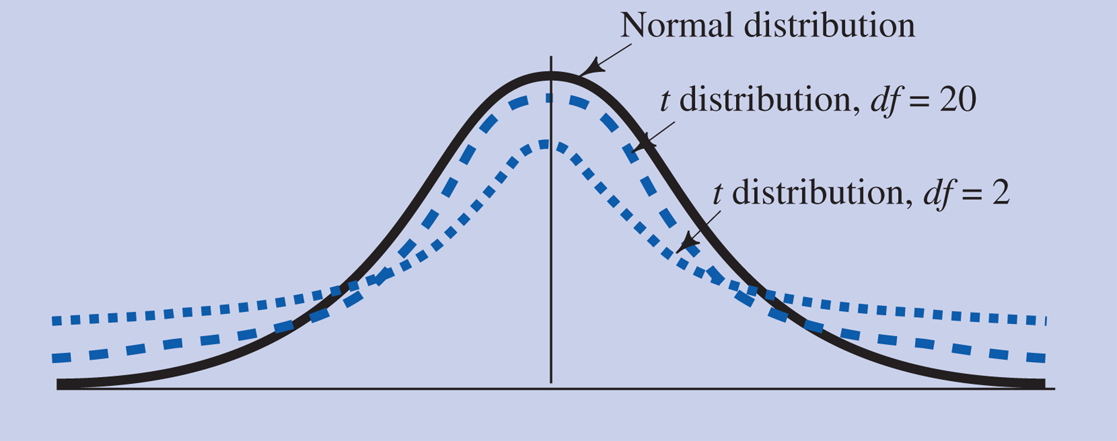
Figure 7-2 t distributions (dashed blue lines) compared to the normal curve (solid black line).

Slide 16
t Distributions -2
There is one t distribution for each number of degrees of freedom
  The greater the number of degrees of freedom, the closer the t distribution is to the normal curve
  When there is an infinite number of degrees of freedom, the t distribution is the same as the normal curve.

Slide 17
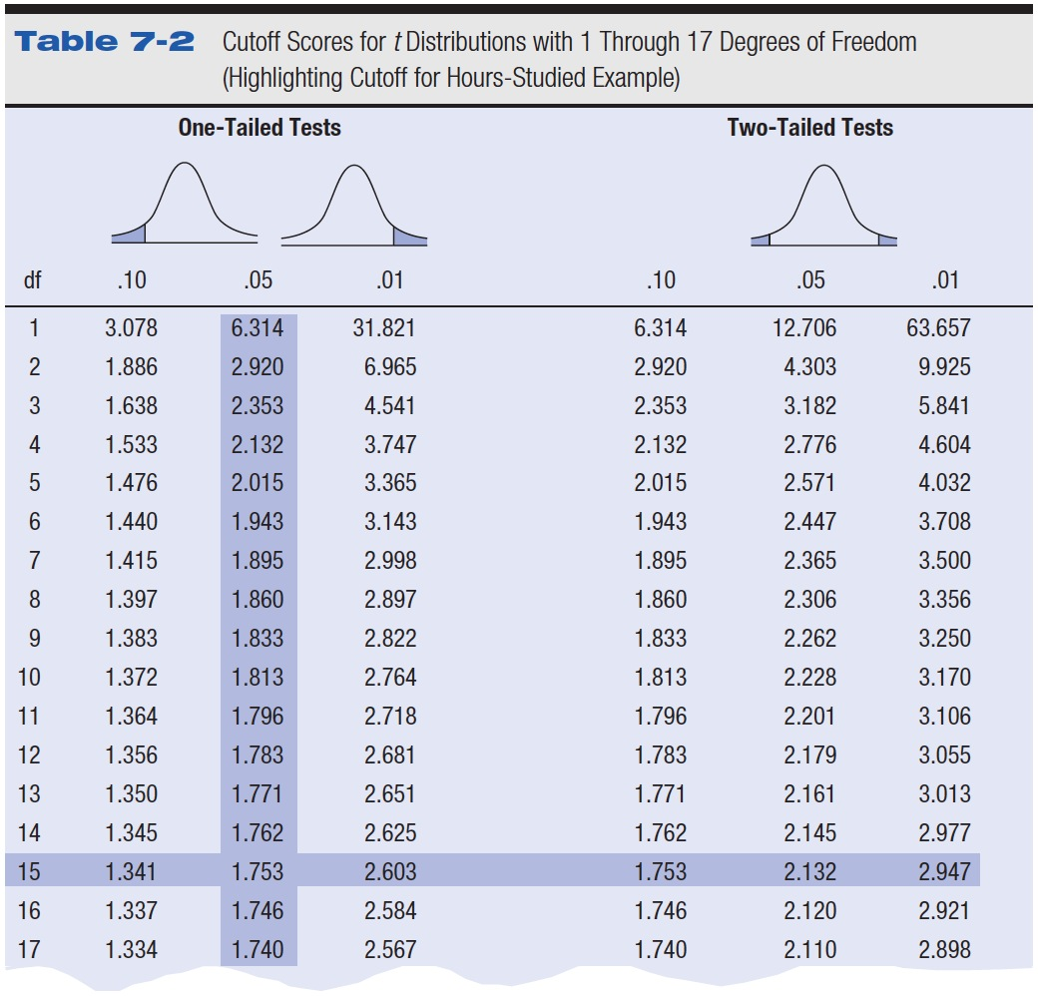
Table 7-2 Cutoff Scores for t Distributions with 1 Through 17 Degrees of Freedom (Highlighting Cutoff for Hours-Studied Example)

Slide 18
t Test for a Single Sample -1
Used to compare a sample mean to a known population mean, but the variance of the population is unknown

Slide 19
t Test for a Single Sample -2
Estimating the population variance from the sample scores
  Biased estimate of the population variance
  Unbiased estimate of the population variance (S²)

Slide 20
t Test for a Single Sample -3
Degrees of freedom
  Number of scores that are
  “free to vary”
Formula for S² using degrees of freedom

Slide 21
t Test for a Single Sample -4
The variance of the distribution of means
The standard deviation of the distribution of means

Slide 22
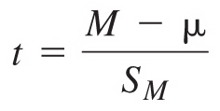
t Test for a Single Sample -5
Locate the appropriate cutoff sample score for rejecting the null hypothesis in the t table
Locate the sample mean score on the comparison distribution by calculating a t score using

Slide 23
Hypothesis Steps
1. Define the Null and Research
  Null: sample (always first!) ____ population (“the normal group”)
  Res: sample ____ population
  Can use more/less/different hypothesis from Z

Slide 24
Hypothesis Steps
2. Comparison distribution
  Mu (population mean – given to you)
  M (sample mean – calculated)
  Sm (standard deviation of the distribution of means, remember this is N-1 S)
  Df = N - 1

Slide 25
Hypothesis Steps
3. Cut off sample score
  You will use the new t-chart to get cut off score
  Figure 1 or 2 tails (left versus right side)
  Figure DF (N-1)
  Remember 2 tails is both + and -

Slide 26
Hypothesis Steps
4. Figure the sample score
  T = (M – mu) / Sm

Slide 27
Hypothesis Steps
5. Do you reject?

Slide 28
T-test for Dependent Means
Repeated measures designs – two scores for each person and population variance is not known

Slide 29
t Test for Dependent Means
Unknown population mean and variance
Same procedure as t test for single sample, except
  Use difference scores
  Assume that the population mean is 0 (that’s the second group)
Copyright © 2009 Pearson Education, Inc. Upper Saddle River, NJ 07458. All rights reserved.

Slide 30
t Test for Dependent Measures
Problem:
You have to think about how you are subtracting…
Most people do Before – After
  So if you have a positive score – that means the average went down
  Negative score – average went up

Slide 31
t Test for Dependent Measures
Personally – I like to do After – Before because:
  Positive scores = increase from before to after
  Negative scores = decrease from before to after
** please check these on the HW/PT – I don’t think I’ve assigned any of the stupid confusing ones, but ask if you aren’t sure.

Slide 32
Assumptions
Assumption – condition required for carrying out a particular hypothesis testing procedure
Copyright © 2009 Pearson Education, Inc. Upper Saddle River, NJ 07458. All rights reserved.

Slide 33
Assumptions of the t Test
Normal population distribution
  t tests are robust to moderate violations of this assumption

Slide 34
Assumptions
Robustness – extent to which a particular hypothesis testing procedure is reasonabily accurate even when assumptions are violated

Slide 35

Effect Size for the t Test for Dependent Means
small d = .2
medium d = .5
large d = .8

Slide 36
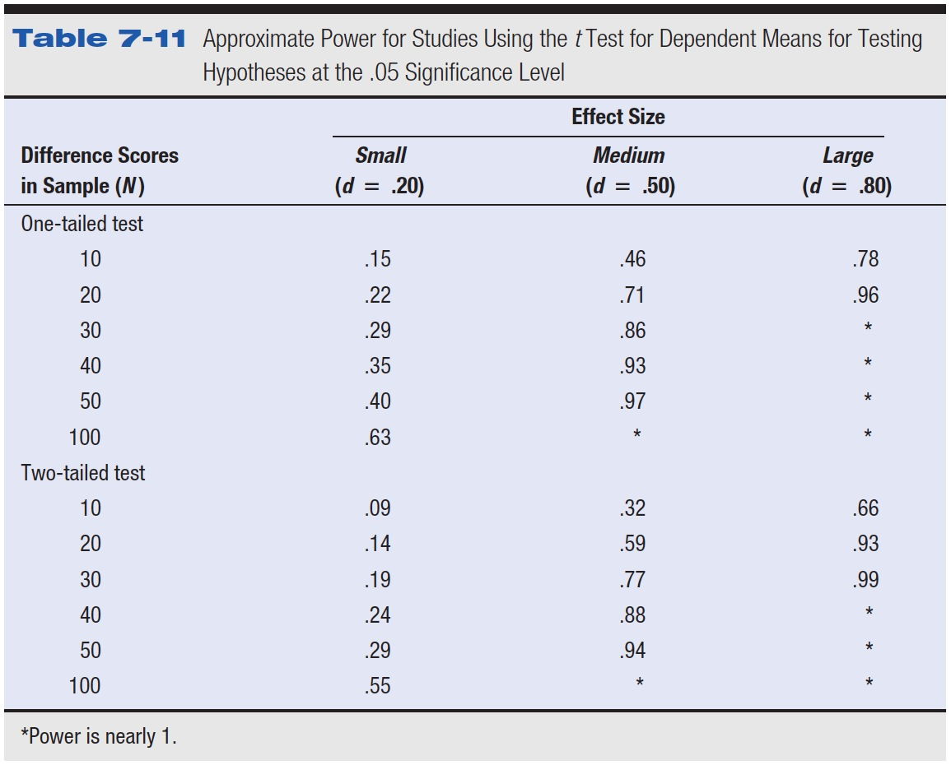
Table 7-11 Approximate Power for Studies Using the t Test for Dependent Means for Testing Hypotheses at the .05 Significance Level

Slide 37
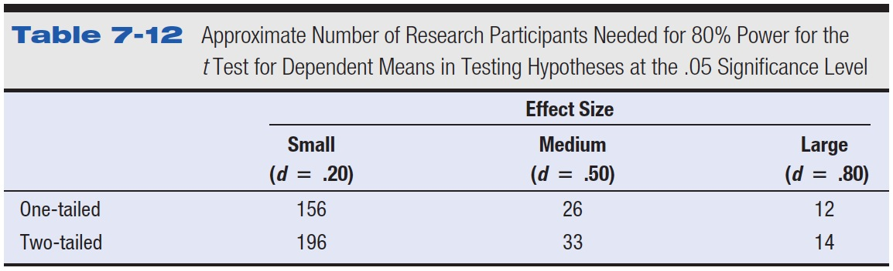
Table 7-12 Approximate Number of Research Participants Needed for 80% Power for the t Test for Dependent Means in Testing Hypotheses at the .05 Significance Level

Slide 38
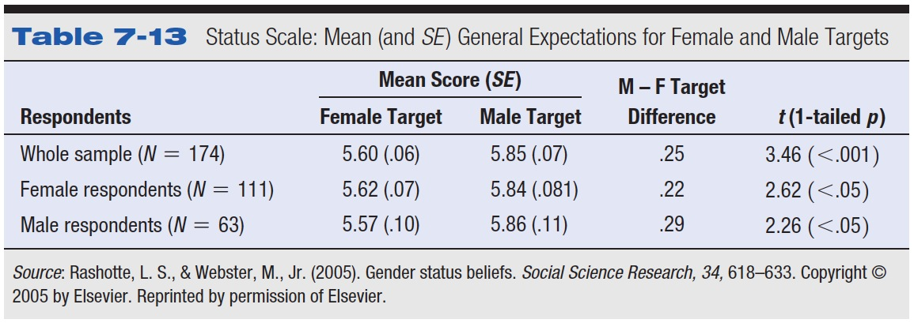
Table 7-13 Status Scale: Mean (and SE ) General Expectations for Female and Male Targets

Slide 39
Controversies and Limitations
Repeated measures designs
  Have high power
    Standard deviation of difference scores usually low

Slide 40
A social psychologist gave a questionnaire about concern for farm workers to seven participants before and after they attended a film about union organization of farm workers. The results are shown below with high scores meaning high concern. Using the .05 significance level, do these results support the hypothesis that the film affected concern for the lives of farm workers?
Scores on the Concern Measure
Participant Before After
A 17 20
B 7 4
C 10 11
D 13 15
E 8 5
F 9 8
G 11 14

Slide 41
A consumer psychologist asked to test a claim by a swimming school that its instructors could teach the average seven-year-old to swim across an Olympic-sized pool in less than 2 minutes. The psychologist arranged for eight randomly selected seven-year-old children to take lessons at the school and recorded how long it took each child to swim across a pool at the end of the lessons. The times (in seconds) were 60, 120, 110, 80, 70, 90, 100, and 130. What conclusion would the psychologist draw following using 120 seconds as the "known" population mean and the .05 significance level?

Slide 42
An organizational psychologist is hired as a consultant to a company planning to open a coffee house for college students. The company wants to know if their customers will drink more coffee if the coffee house is decorated in a Paris motif or in a San Francisco motif, so the psychologist sets up two similar rooms with the two motifs. Eight students spend an afternoon in each room, drinking all the coffee they like. The order in which they sit in the rooms is rotated so that half spend their first afternoon in the Paris room and half in the San Francisco room. The amount of coffee each participant drinks in each room as shown below. Using the .05 significance level, is there a significant difference between the numbers of cups of coffee consumed in the two rooms?
Cups of Coffee
Participant Paris San Francisco
A 8.5 8.4
B 4.3 4.6
C 2.0 1.7
D 7.8 7.3
E 7.0 7.2
F 9.1 7.4
G 3.3 3.0
H 3.5 3.5

